Slide 1
Big Data Architecture and Governance
Individual Project | Tesla
Aaradhy Sharma

Slide 2
1. Selection Assignment

Slide 3
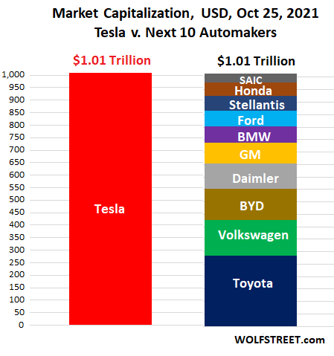
Tesla
Industry: Automotive, and energy generation and Storage
History/Background:
Tesla initially known as Tesla Motors was founded in 2003 by Martin Eberhard and Marc Trepanning in San Carlos.
The name tesla comes after a Genius Inventor Nikola Tesla who is known for his discoveries and invention in the field of electricity
Elon Musk join Tesla in 2004 and has become head of the chairman.
Tesla currently has the highest market cap of all car manufacturer

Slide 4
2. Project Mandate
Complete the required mandate information for each of your projects using the provided template.
Read the instructions carefully.

Slide 5
Project Mandate
Project Name: Improving Quality Assurance Page 1/2
Project Overview
Tesla Currently facing Quality Assurance issues with the production of its cars such as model 3, Model X, Model Y, and new Model S Plaid With the help of Big data Net time required in quality assurance can be decreased on callbacks of cars for minor faults can be reduced or several other faults can be detected in existing cars.
Business Issues/ Opportunities
Current customer has issue with quality of newest of model
Vehicle manufacturing time
Project Objectives
Decrease the time used in Quality assurance for Tesla Cars
Reduce Number of callbacks for car due to minor issue
Develop a robust data network system to monitor vehicle performance so early callbacks or batch callbacks can be performed

Slide 6
Project Mandate
Project Name: Improving Quality Assurance Page 2/2
Scope
The project will improve Quality assurance and improve the overall product lifecycle of Tesla cars. The dependencies would be to gather data points and The current manufacturing process.
Constraints
Some of the constraints that can happen to a project are time demands. Initial lack of data points cost to benefit ratio
Interfaces
The project will interface with several other projects such as the Tesla customer feedback network, manufacturing department Research and development team, Service department,
Customers And Users
The main Beneficiary of this Projects would be Quality Assurance Team, CTO, Chief Manufacturing Officer, Manufacturing Team, New Customer, Pre-Existing customer

Slide 7
Project Mandate
Project Name: Improving Battery Life Cycle Page 1/2
Project Overview
Tesla is in the business of Battery manufacturing and energy Storge as well Installing their Charging plant In the US, Eu, and China. Currently, there is a big issue with battery Life as over a long period of time battery life is said to deteriorate Using Big Data, we can predict battery deterioration get data from users on its usage. And improve the overall Battery lifecycle.
Business Issues/ Opportunities
Battery Drainage issue
Optimal Battery charging issue
Improving current charging infrastructure according to data
Extending overall battery life
Project Objectives
Gather data from users on there battery usage
Get estimate on when battery quality Deteriorate
Using big data to fin ideal charging way

Slide 8
Project Mandate
Project Name: Improving Battery Life Cycle Page 2/2
Scope
The scope of this project would be a Deliver project that can accurately predict based on battery life. And its deterioration time is based on usage by data such as its charging time.
Constraints
The product can have constraints such as cost to benefit ratio. The innovation in battery tech such as sodium ion could be a constrain for this project.
Interfaces
The project will interact with other products such as the customer feedback department, Research, and Development and Onboard software, and Sensors
Customers And Users
The current tesla owner would be existing customer, as well as charging station owner.

